Slide 1
Measuring Immigrant Integration
David Laitin, IPL, Faculty Co-Director
Niklas Harder, DeZIM, Department Co-Head
Marine Casalis, IPL, Program Director
Adam Lichtenheld, PhD, IPL, Executive Director

Slide 2
Agenda
Introduction
Background and Motivation
Process and Methods
Overview of Dimensions and Questions
Adapting the Index to Different Contexts
Example Applications and Uses
Conclusion
Q&A
During the presentation: Submit questions using the Q&A feature
During the Q&A session: Use the raise hand feature and a host will unmute you

Slide 3
Panelists
MODERATOR
Adam Lichtenheld
Executive Director Stanford Immigration Policy Lab
PANELIST
David Laitin
Professor of Political Science and Faculty co-Director
Stanford Immigration Policy Lab
PANELIST
Niklas Harder
Co-head of Integration Department
DeZIM Institute
PANELIST
Marine Casalis
Program Director
ETH Zurich Immigration Policy Lab

Slide 4
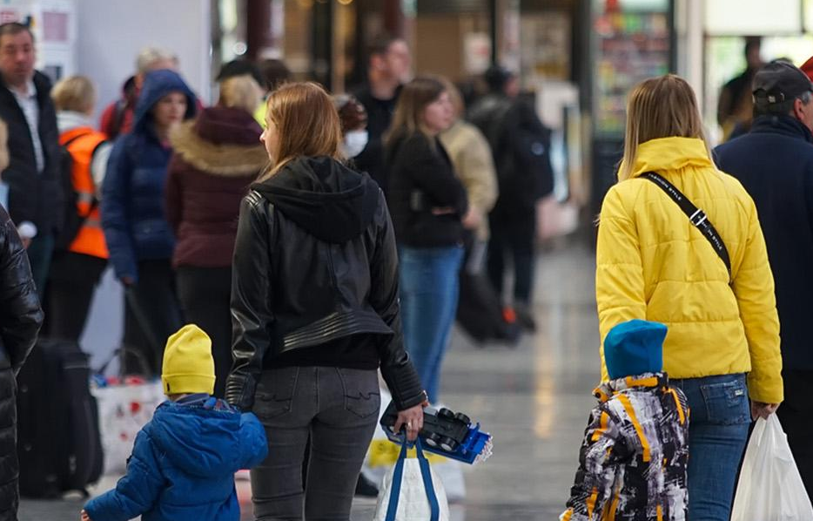
Immigration Policy Lab
We use big data, creative research designs, and cutting-edge analytical tools to generate rigorous evidence and innovative solutions to help policymakers make more informed decisions on migration.
We partner with governments, nonprofits, and service providers working on the frontlines of migration to design and evaluate policies and programs affecting refugees, asylum-seekers, and immigrants around the world.

Slide 5
IPL Integration Index (IPL-12 or IPL-24)
Motivations
Goal
Migration researchers lack a consensus on how to measure integration
Each study relies on its own specification of integration, reducing possibilities for comparative research and cumulative knowledge about integration success
Develop a standardized survey measure of the degree to which migrants have the knowledge and capacity to achieve success in their host society.
immigrationlab.org/ipl-integration-index/

Slide 6
Criteria for a Useful Measure
Construct validity
Clear directionality
No presumption that the cultural repertoires of dominant group(s) in the host society are a model for integration (integration ≠ assimilation)
Can be successfully employed across groups, societies, and over time
Can be administered through different modes (phone/online/in-person)
Recognizes the multidimensionality of the concept

Slide 7
Design Process
Harder, Niklas, et al. (2018). “Multidimensional measure of immigrant integration.”
Proceedings of the National Academy of Sciences, 115(45): 11483-11488.
Reviewed more than 50 surveys on integration
Selected 200+ questions with the potential to differentiate between high and low integration
Focused on questions used in different fields
Searched for a limited number of dimensions where there are expectations of differential rates of integration progress
Conducted consultations and focus groups with different immigrant groups
8 surveys and one round of face-to-face interviews to develop the tool
4 surveys to validated the tool
Notes:
Read the original paper: https://www.pnas.org/doi/full/10.1073/pnas.1808793115
Explore supplementary information, including questions and background on the survey:
https://www.pnas.org/action/downloadSupplement?doi=10.1073%2Fpnas.1808793115&file=pnas.1808793115.sapp.pdf

Slide 8
Six Dimensions of Integration Success
Dimension | Questions (IPL-12) | Questions (IPL-24)
Psychological | ● Connection to host country ● Feeling like an outsider | ● Living in the future ● Feeling of isolation
Economic | ● Income ● Employment status | ● Paying unexpected but necessary expenses ● Satisfaction with employment
Political | ● Subjective knowledge ● Discuss major political issues | ● Four item quiz ● Political activity
Social | ● Dinner with locals ● Social contacts | ● Participation in groups and associations ● Providing favors to locals
Linguistic | ● Reading level ● Speaking level | ● Writing level ● Listening comprehension
Navigational | ● See a doctor ● Find jobs | ● Get help with legal problems ● Four item quiz

Slide 9
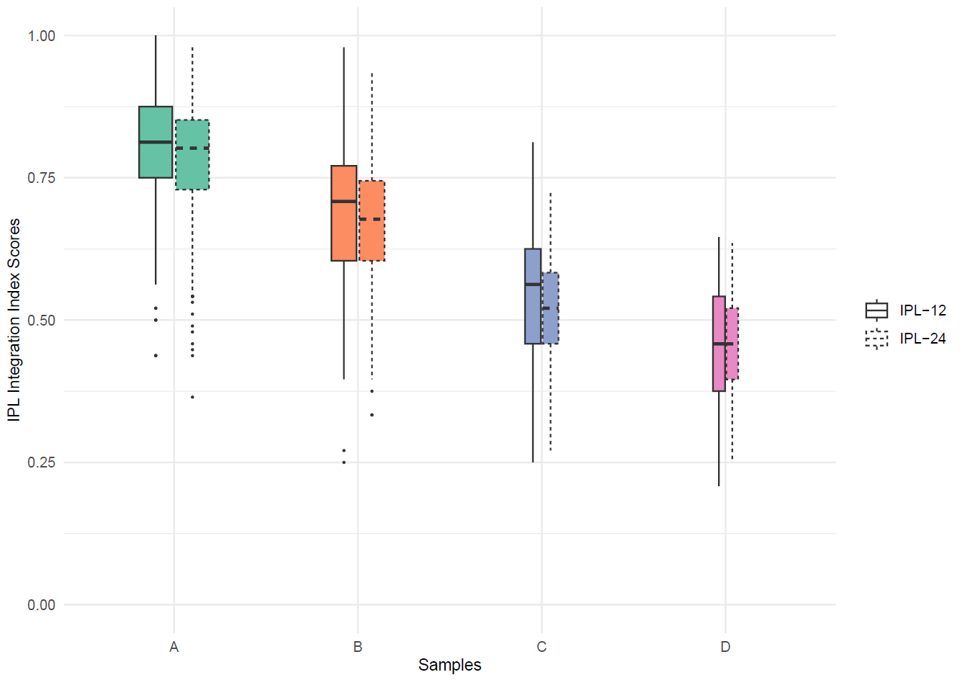
Validation: Contrasted Groups

Slide 10
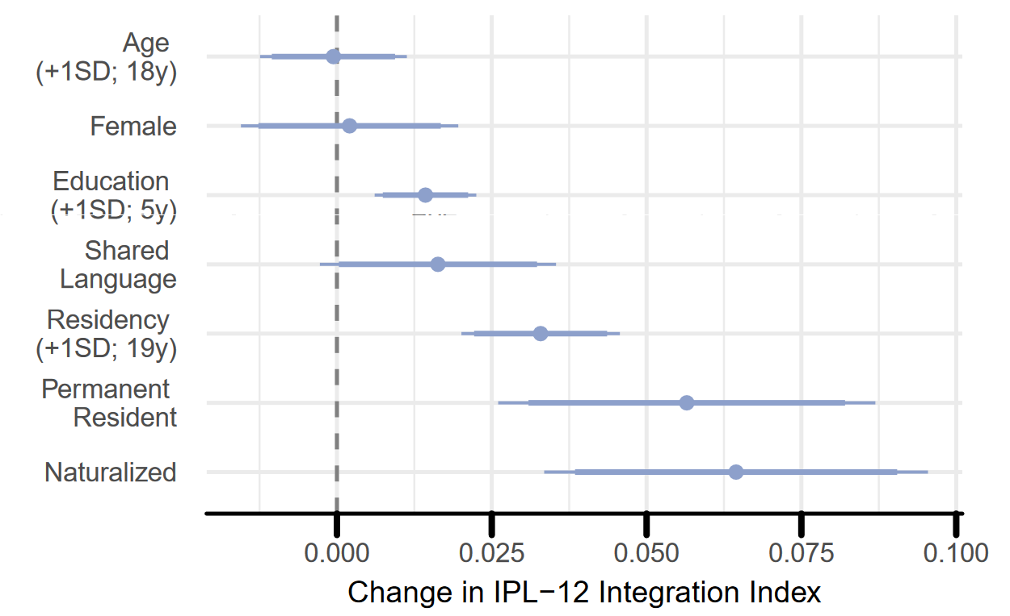
Correlations with the IPL-12 Integration Index

Slide 11
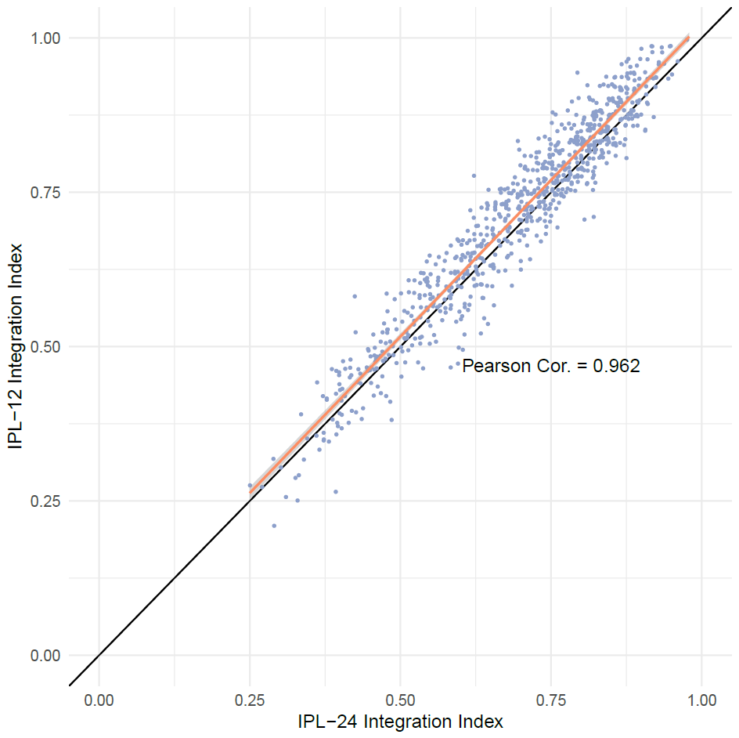
IPL-12 vs. IPL-24: trade-offs
Both indexes produce a single measure of integration between 0 and 1.
The IPL-12 is a subset of the IPL-24, the scores are highly correlated.
The IPL-24 takes three times as long to administer, it is usually sufficient to use the IPL-12.
If a certain integration dimension is of special interest and should be measured with more precision, the additional IPL-24 questions from the respective dimension can be added.

Slide 12
Adapting the index to different contexts
Study | Country | Respondents
“Home for Good? Obstacles and Opportunities for Refugees and Asylum Seekers in Greece.” M. Casalis et al. | Greece | Refugees and asylum seekers
Multidimensional Integration Measurement Toolkit (multiple reports) | Brazil, Dominican Republic, Peru | Venezuelan and Haitian migrants
IPL, Civic and linguistic training for immigrants | France | Asylum seekers
Naturalize New York (multiple studies). M. Hotard et al. | United States | NY permanent residents
“The Dynamics of Refugee Return.” A. Alrababa’h et al. | Lebanon | Syrian refugees
“Seeking connection.” R. Miller et al. | Japan | International migrants
“Integration Is Correlated With Mental Health.” S. Harris et al. | Norway | Syrian refugees
“A transdiagnostic psychological intervention for Afghan asylum seekers & refugees in Austria.” M. Knefel et al. | Austria | Afghan asylum seekers
“Assessing the Level of Immigrant Integration in Finland.” J. Kunwar et al. | Finland | Immigrants from 36 countries

Slide 13
Translating the tool
Offer the questionnaire in the native language of the respondents, at a level that is easy to understand.
Adapt to the country of research and the host country's citizens (e.g. Greeks instead of Americans).
The index prioritizes simplicity and uses the more general term Americans to refer to the rooted population instead of more specific terms such as American citizens (by birth).
In cases where there are 2 or more official languages, the language referenced in the survey should be the language migrants will need to understand important legal information, speak with authorities, and succeed in the workplace.

Slide 14
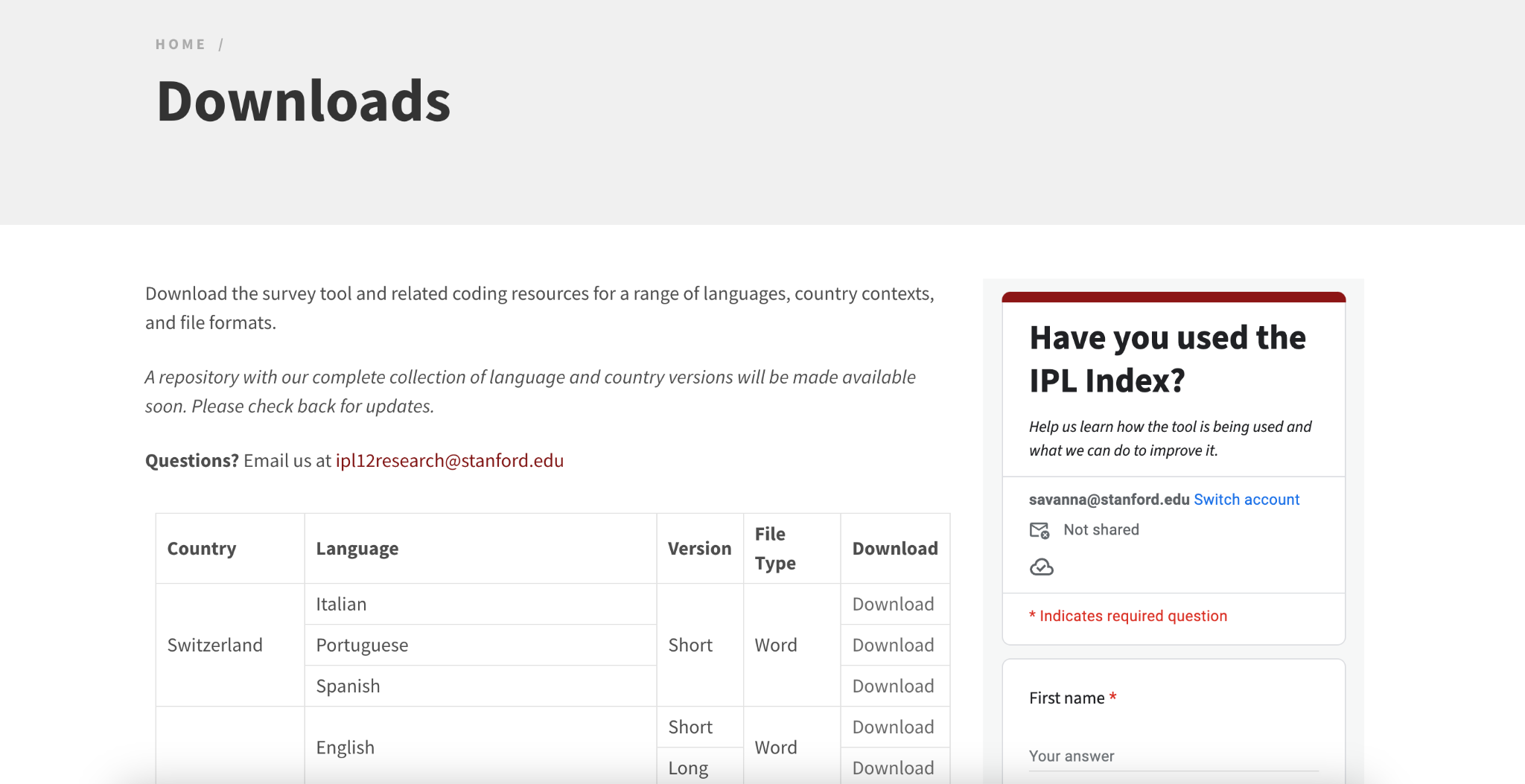
Downloads page
Notes:
Explore survey downloads on our site: https://immigrationlab.org/ipl-integration-index/downloads/

Slide 15
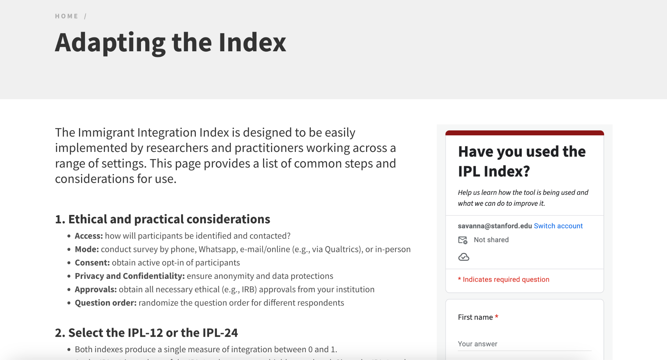
Adapting the index
Notes:
Read about how to adapt the index: https://immigrationlab.org/ipl-integration-index/adapting-the-index/

Slide 16
Adapting the economic dimension
The question on income should ask for a value (i.e., net/gross; monthly/yearly) that satisfies two criteria:
Respondents should be likely to know the value as it is most commonly used in contracts or discussions with colleagues.
There should be an up-to-date statistic of the median value of the respective income type (check census data, the national statistical office, the country’s central bank, and other academic articles).
Check if the definition of a household makes sense in a given context “everyone with whom you share an apartment or house and with whom you are also related by birth, marriage, partnership, or adoption.”

Slide 17
Adapting the economic dimension (cont.)
Check for implausible or additional employment situations.
A score of one is assigned if a respondent is unemployed and has no other daily activity that keeps them from working.
A score of three is assigned if a respondent is in unpaid work, in school, or is unemployed due to sickness, disability, or old age.
A score of five is assigned if a respondent is employed or earns an income in a different way (e.g., through military service).

Slide 18
Adapting the political dimension
Requires a good understanding of the context the population of interest lives in.
Pay particular attention to these questions in the pilot survey and remove them if you fear that they will lead to distrust or unfinished surveys.
Sometimes the political situation may have severely affected the target population to the point that it may be better to drop the IPL-24 questions of that dimension and just keep the IPL-12 ones, or remove this set of questions entirely.

Slide 19
Adapting the navigational dimension
These questions must be adapted to the local context. If the original questions work for a given context, then only the answers need to be adapted (e.g. it is common to send letters in France, but addresses look different than in the U.S.).
If the original questions do not work in the context of interest, users can design new questions. Examples can be found in the survey instruments for Brazil, Peru and Dominican Republic on the IPL Integration Index website.
When designing new questions, pay attention to the difficulty level of the question. They have to be specific to a context but very much common knowledge in the given context.
Notes:
Find surveys and reports from our IOM partnership in Brazil, Peru, and Dominican Republic on our website: https://immigrationlab.org/ipl-integration-index/latin-america-caribbean/

Slide 20
Adding or removing questions
Do not drop questions unless they might put respondents at risk and/or are deemed too sensitive. Even if there will be little variation in responses, it is still better to keep the question.
The index was not designed to capture all possible aspects of migrant integration. Adding questions is fine as long as they are not used in the calculation of the index and they do not measure similar concepts as the integration index questions.
It is best to use pre-tested questions, which can be found in the Global Survey Bank on Migrant Integration and Social Cohesion or other surveys on migrant integration.
The IOM/IPL Integration Index Calculator shows how the index scoring works using an example from the IOM/IPL survey on integration implemented in Brazil.

Slide 21
Greece - Application
IPL partnered with UNHCR, Mobile Info Team and the International Rescue Committee (IRC)
Two main goals:
Explore the integration challenges of refugees and asylum-seekers in Greece
Evaluate the effect of providing information to people on the move
Survey with 3,755 displaced persons including the IPL Integration Index
Notes:
More on our research in Greece with UNHCR and IRC can be found on our website: https://immigrationlab.org/project/home-good-obstacles-opportunities-refugees-asylum-seekers-greece/ and working paper on information provision: https://osf.io/preprints/socarxiv/n3p62

Slide 22
Greece - Findings
Integration challenges:
Two dimensions with highest scores: the psychological and economic dimensions
Although two-thirds were unemployed, with a pronounced gender disparity
About half the sample stated that they would like to stay in Greece
Information provision evaluation:
There was a higher take-up for generic information
But personalized information had a higher effect on knowledge of exploitation and coping with violence
We could not identify any effect on integration

Slide 23
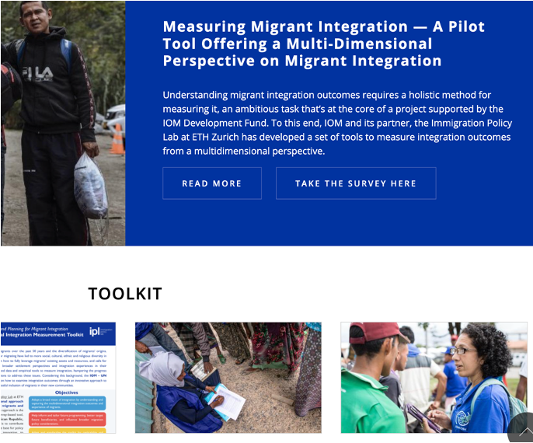
Latin America and the Caribbean - Application
IPL partnered with IOM to adapt the Integration Index to Brazil, Dominican Republic (DR), and Peru

Slide 24
Latin America and the Caribbean - Application
IPL partnered with IOM to adapt the Integration Index to Brazil, Dominican Republic (DR), and Peru
Two main goals:
Descriptive analysis of the integration of Venezuelans and Haitians in Brazil and DR
Evaluation of a cash-based intervention supporting Venezuelans in Peru
Survey with > 4,800 beneficiaries of IOM programs including the IPL Integration Index
Notes:
Read about the survey version we created with IOM and get the toolkit: https://immigrationlab.org/ipl-integration-index/latin-america-caribbean/

Slide 25
Latin America and the Caribbean - Findings
In Peru, a one-time cash transfer of 760 soles (~190 USD or 74% of monthly minimum salary)
Increased integration
→ Mostly driven by the social, economic, and navigational dimensions
Fostered intentions to emigrate
Notes:
Find the working paper “Cash-Based Interventions Improve Multidimensional Integration Outcomes of Venezuelan Immigrants” at https://osf.io/preprints/socarxiv/5sh8a

Slide 26
Conclusion
The IPL Integration Index offers a versatile survey tool for measuring integration
Has construct validity
Shows multidimensionality of integration
Available in several languages
Applied in a variety of countries and contexts
Minor adaptations needed to tailor to different contexts
Linguistic integration questions
Political integration questions
Computation of scores (on website) makes for easy comparison

Slide 27
Thank You!
https://immigrationlab.org/ipl-integration-index/

Slide 28
Q&A

